Slide 1


PREDICTING MUSCLE FORCE OUTPUT USING EMG ACTIVITY
Michael Adams, Tyler Simpson, Dr. Robert Gaunt
Rehab Neural Engineering Laboratory
University of Pittsburgh

Slide 2
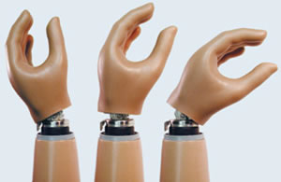
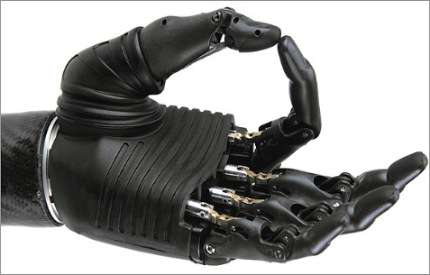
Hand Prosthetics
50,000 new amputees every year in USA
Many challenging design considerations
- Functionality
- Human-machine interface
- Material biocompatibility
- Aesthetics
- Input source
http://www.wired.co.uk/article/darpa-creates-feeling-prosthetic-arm
Notes:
50,000: need, particularly for soldiers
Functionality: what can it do? DoF, range, strength, hand shape

Slide 3
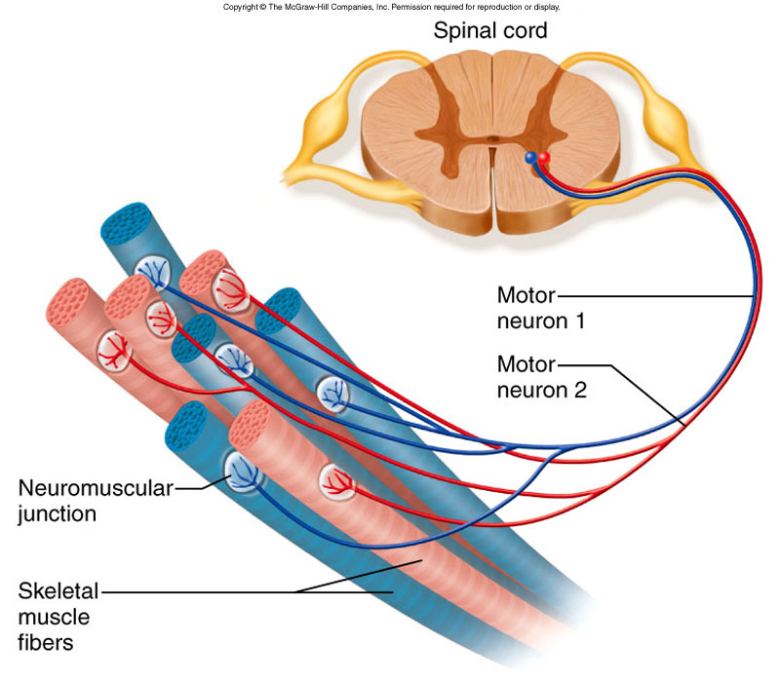
Input Source: Terminology
Motor Unit: motor neuron and the muscle fibers it innervates
https://kin450-neurophysiology.wikispaces.com
Notes:
Before we talk about input source process its important to understand terminology

Slide 4
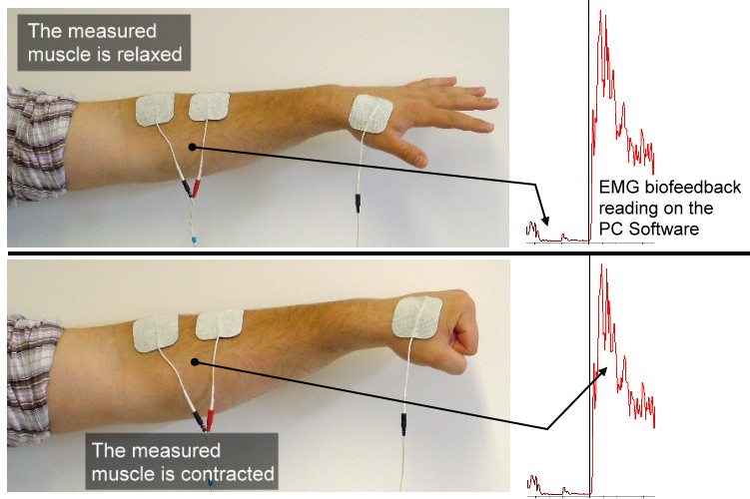
Input Source: Terminology
Electromyography (EMG): measure voltage changes in muscle
http://veritymedical.co.uk/

Slide 5
Input Source: Overview
Muscle Activity
CNS (Motor Unit)
Hand Movement
EMG Activity
Boostani et al. 2003
Muceli et al. 2015
Muscle Activity
CNS (Motor Unit)
Prosthetic Movement
EMG Activity
Notes:
Summarize input source process
Explain lab approach
What: Improve understanding of relationship between complex forearm muscle activity and EMG activity to make prosthetic movement more realistic
How: record EMG activity and hand kinematics from healthy human during hand movement, then explore relationships between data

Slide 6
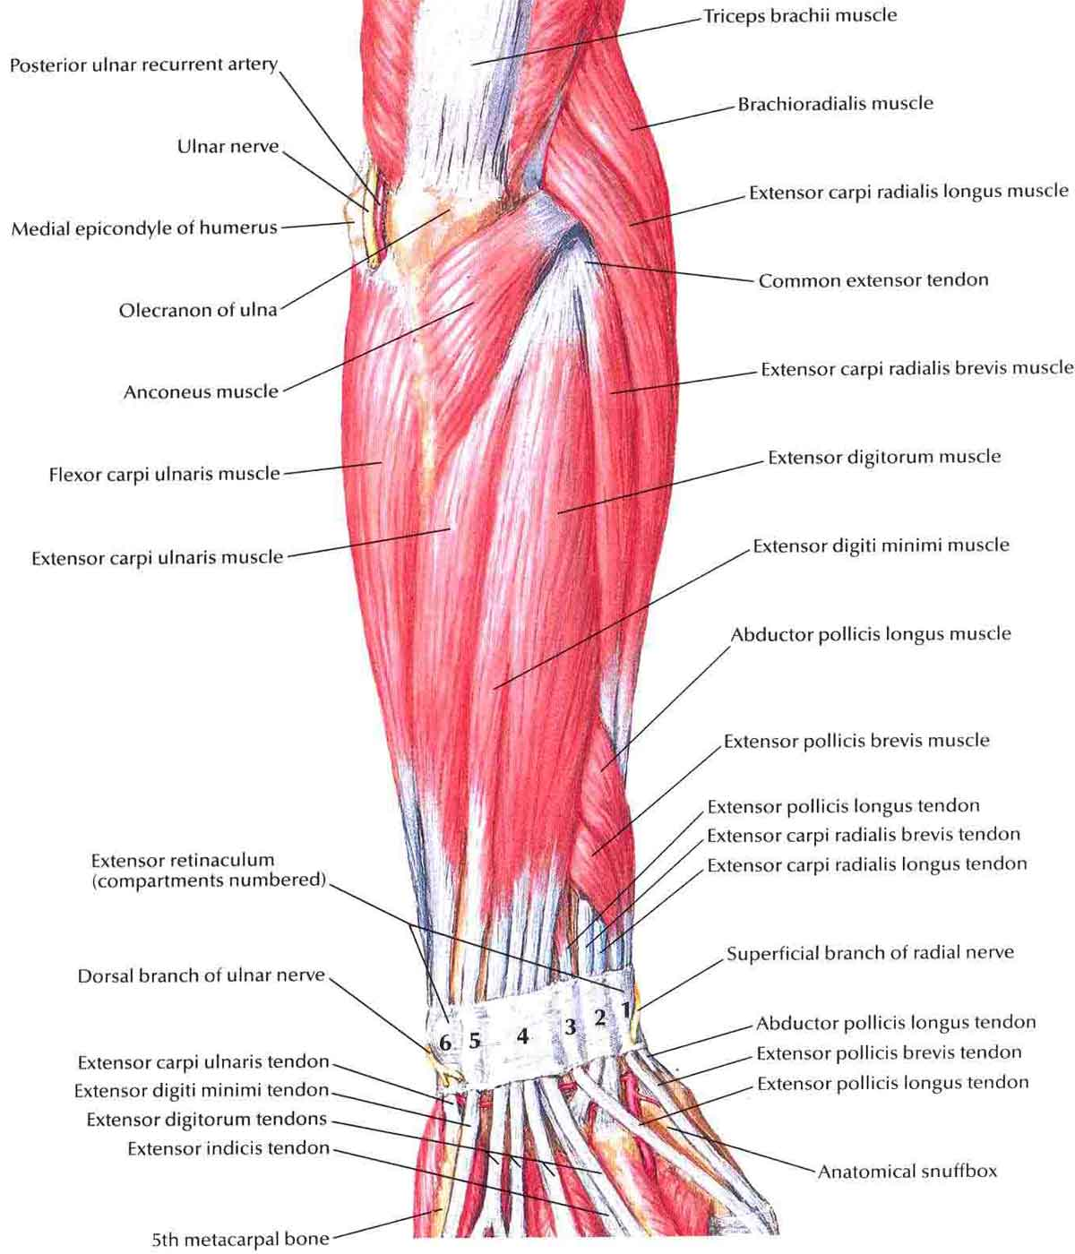
Input Source: Challenges
Forearm muscle activity is very complex
How best to record EMG?
How best to extract motor unit activity (spikes) from EMG?
http://www.muscleseek.com/muscles-anatomy-muscles-location/forearm

Slide 7
Objective
Extract useful parts of EMG data
- how many motor units are being recorded?
- when are they firing?
Analyze industry standard methods for extracting motor unit activity from EMG signal
- Offline Sorter
- EMGLAB
Notes:
Before we can answer questions about relationship b/n muscles, emg activity, and force output we need good data
We’ll talk more about the two programs soon

Slide 8
Success Criteria
Qualitative
- ease of use (automation)
- data compatibility
Quantitative
- cross correlation between motor unit spikes and muscle force output should be high (r >= 0.5)
Notes:
Qual: proprietary equip, software, data compatibility
Quant: we’re testing a relationship we know to be true so if program worked well we expect correlation to be high

Slide 9
Methods
Motor unit spike data
EMG data
Record data during movement
Correlation
Muscle force data
Notes:
Where I fit in relative to overall project

Slide 10
Methods
Motor unit spike data
EMG data
Notes:
Lets look at how I did this

Slide 11
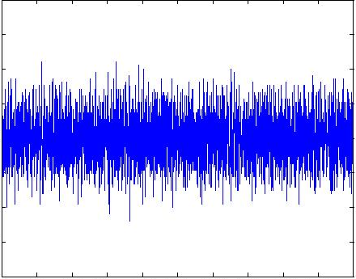
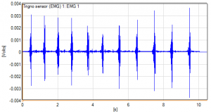
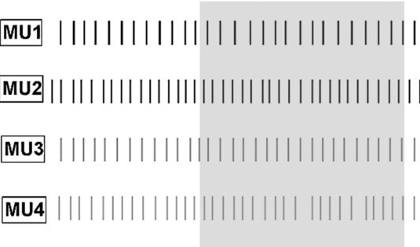
Extracting Motor Unit Activity
Motor Unit Data
Raw EMG
Filtered EMG
Motor Unit Sorting Program
Filtering Protocol
Notes:
Get a feel for what I did specifically

Slide 12
Extracting Motor Unit Activity
Raw EMG
Filtered EMG
Filtering Protocol

Slide 13
Filtering Protocol
Develop MATLAB code
Import raw EMG data into MATLAB
Filter noise introduced by equipment
Apply accepted filtering protocol
- high pass filtering: remove random noise
- low pass filtering: remove motion artefacts

Slide 14
Extracting Motor Unit Activity
Motor Unit Data
Raw EMG
Filtered EMG
Motor Unit Sorting Program
Filtering Protocol
Notes:
Get a feel for what I did specifically

Slide 15
Extracting Motor Unit Activity
Motor Unit Data
Filtered EMG
Motor Unit Sorting Program

Slide 16
Motor Unit Sorting
Develop MATLAB code for EMG data export
Evaluate industry standard sorting methods
Offline Sorter – proprietary, neural data
EMGLAB – open source, EMG data
Develop MATLAB code for spike data import and analysis
Notes:
Using program
Adjusting parameters
Ease of use
Speed

Slide 17
Results: Summary
New filtering protocol developed and implemented successfully
Offline Sorter and EMGLAB are not viable

Slide 18
Results: Offline Sorter
Qualitative
- Could not accurately sort EMG data into motor units, sorting done mostly by hand
Quantitative
- Inconsistent correlations with muscle force output
- as high as r = 0.7, as low as r = 0.06, average around r = 0.2

Slide 19
Results: EMGLAB
Qualitative
- code is no longer maintained, many version compatibility issues - program could not identify motor unit spikes
Quantitative
- Inconsistent correlations (again)
- as high as r = 0.7, as low as r = 0.07, average around r = 0.3

Slide 20
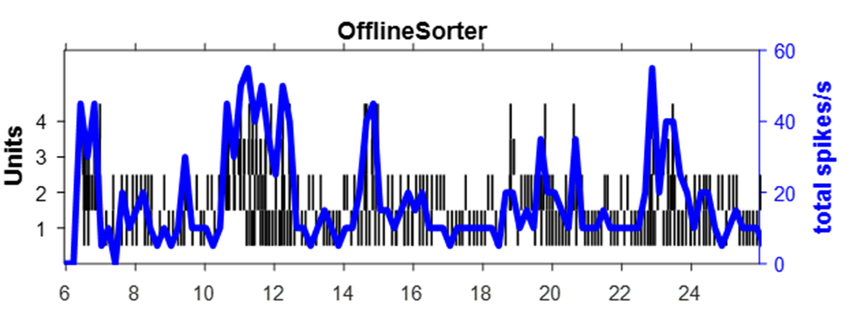
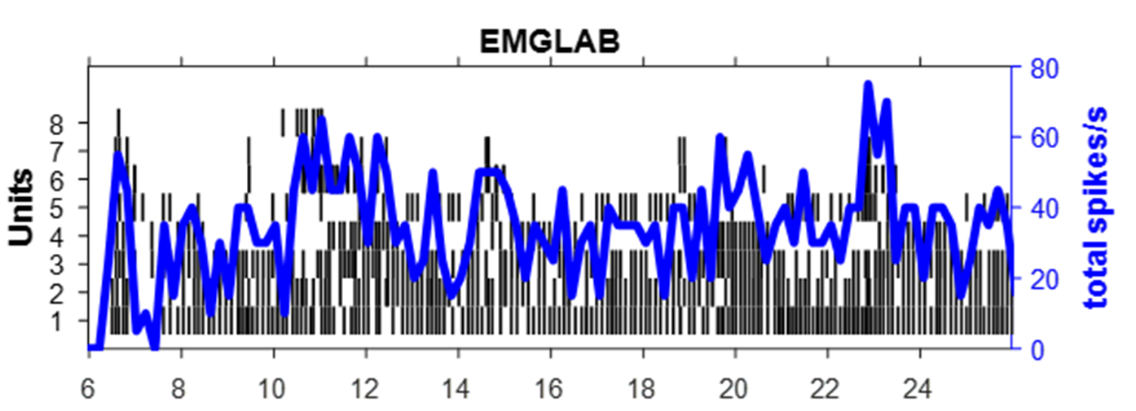
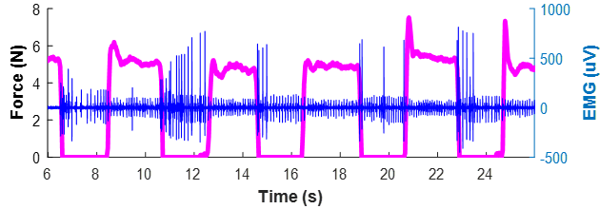
Results: Motor unit correlation to muscle force
r = -0.208
r = -0.337
Notes:
To understand what went wrong lets compare the output from both programs
And look at correlation to muscle force output
But first lets look at how I made these graphs

Slide 21
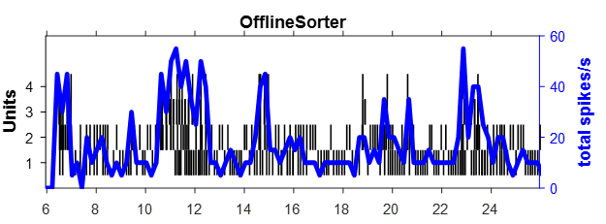
Results: Offline Sorter
Time (sec)
Notes:
Motor unit spike bars
Blue line

Slide 22
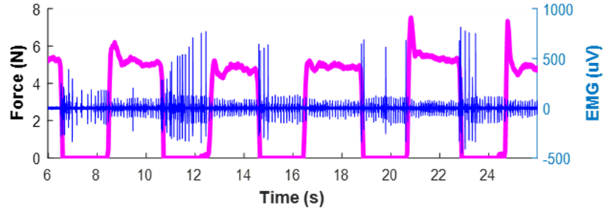
Results: Muscle Output
Notes:
Motor unit spike bars
Blue line

Slide 23
Results: Motor unit correlation to muscle force
r = -0.208
r = -0.337
Notes:
Unit number difference
Different correlations
Hand sorted - error

Slide 24
Discussion
Discovered and filtered a new type of EMG noise induced by equipment
Neither program will work within the context of the main project experimental setup
Cannot yet drive hand prosthetics with accuracy and complexity of a healthy human
Notes:
Our results as they relate to the experiment

Slide 25
Future Directions
Develop new sorting methods
- several proposed in research publications
Reconsider current experimental setup
- implant additional intramuscular electrodes
- add surface electrodes

Slide 26
Acknowledgements
Swanson School of Engineering
Office of the Provost
Sharlene Flescher
Carl Beringer
Jeff Weiss

Slide 27
Questions?
Notes:
Minimum 32 pt font

